Slide 1
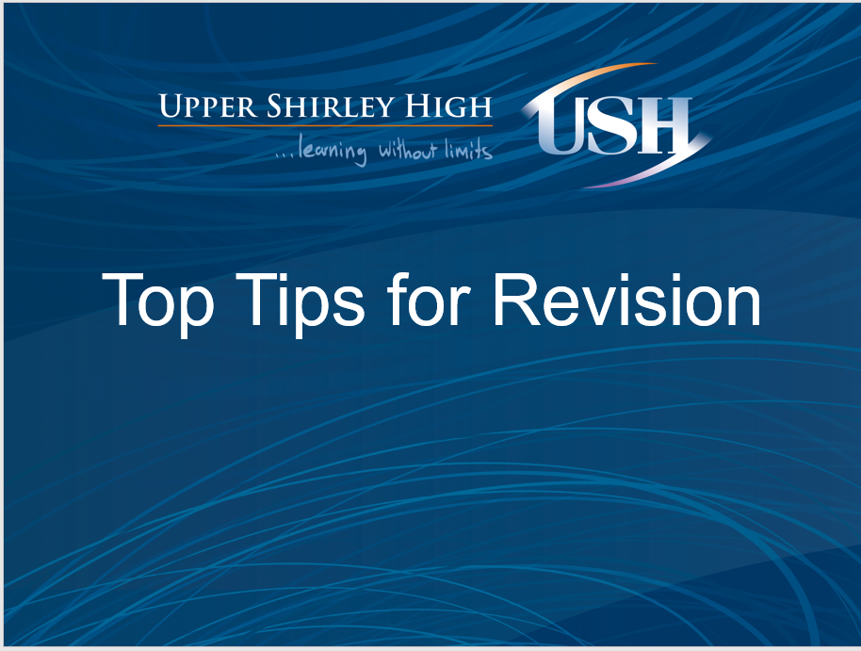

Slide 3
How Does Memory Work?
Information
Decay
Recall
Encoded
Sensory Register
Short Term Memory
Medium Term Memory
Long Term Memory
Filtered: some information goes to Short Term Memory .
30 seconds: lost to decay / interference or refreshed and reinforced through attention and repetition.
1 week
Indefinite

Slide 4
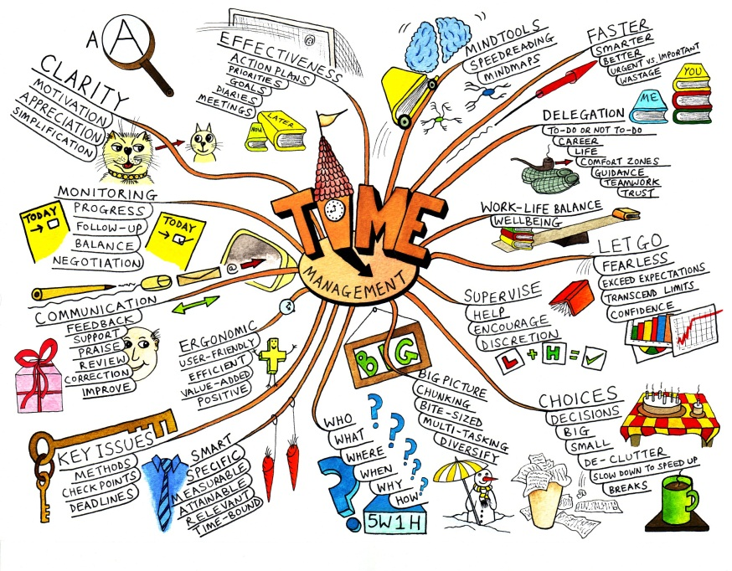
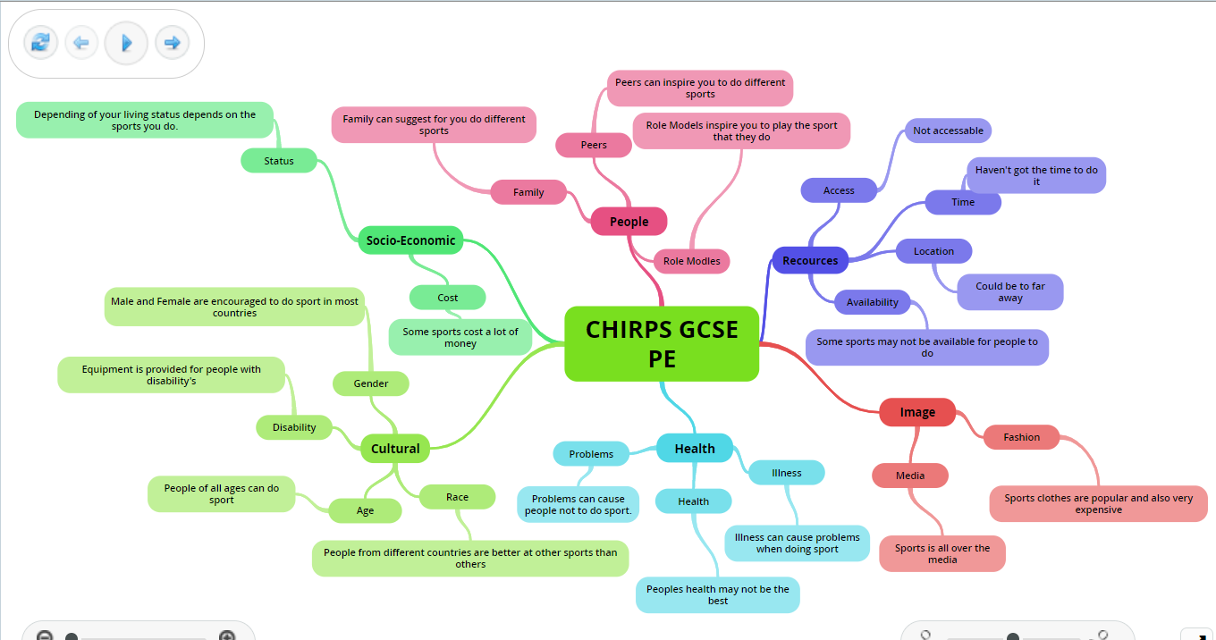
Mind Maps or Spider Diagrams
Key question, exam question or a key topic in the centre;
Subtopics or subheadings;
Add key pieces of information;
Develop some of your points;
Add symbols or images;
Use different coloured pens or highlight different points;
Use different sized pieces of paper.

Slide 5
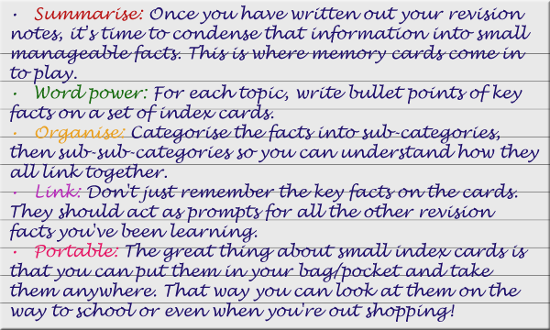
Revision/Flash Cards
A5 or A6;
Key questions, headings or subheadings on each one and key information;
Lots of cards with different information, answering one question;
Move them around or stick them down on larger pieces or paper or around your room with blue tack.

Slide 6

Post it Notes
Colours could represent advantages and disadvantages (training methods)
Definitions
Bullet point the answer to key questions;
Different post it notes, each containing different parts of an answer to one question;
Can be moved around, linked or prioritised.

Slide 7
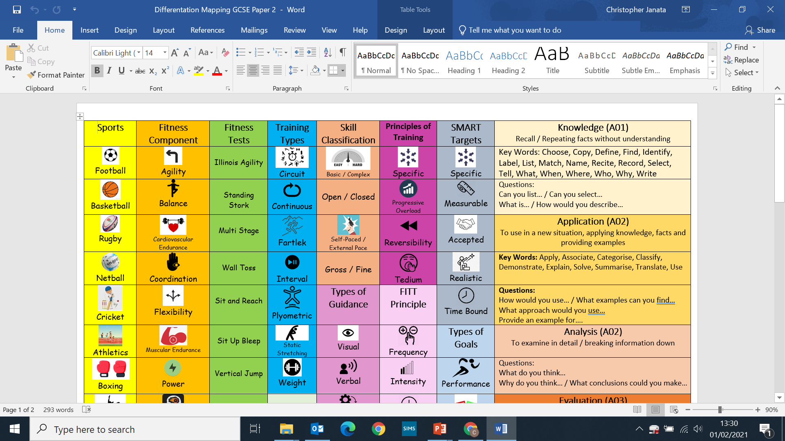
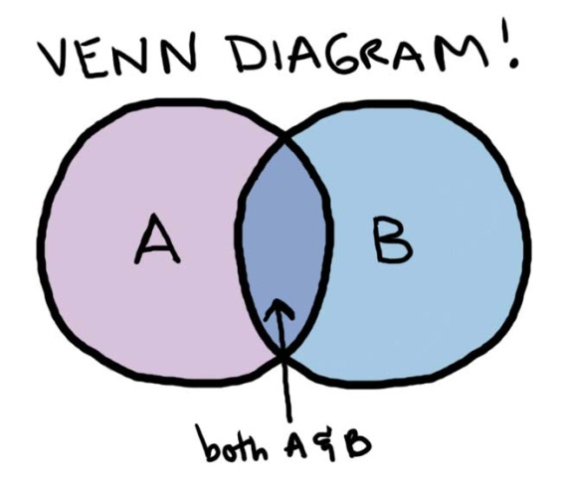
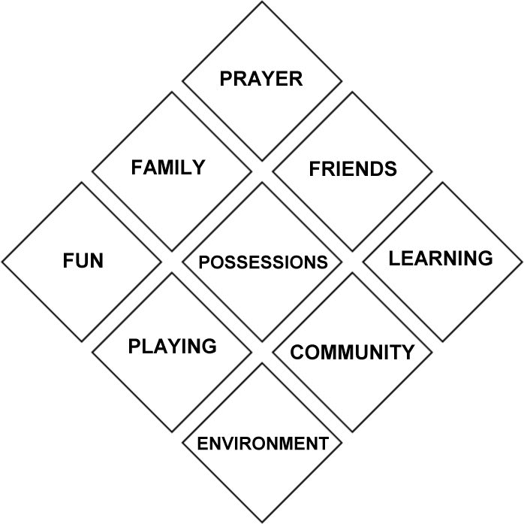
Drawing memory anchors or picture based notes
Combination of key words, numbers and pictures
Create a key
Use a combination of notes and pictures.
You don’t need to draw the pictures/be a good artist. You can always use pictures/templates off the internet

Slide 8
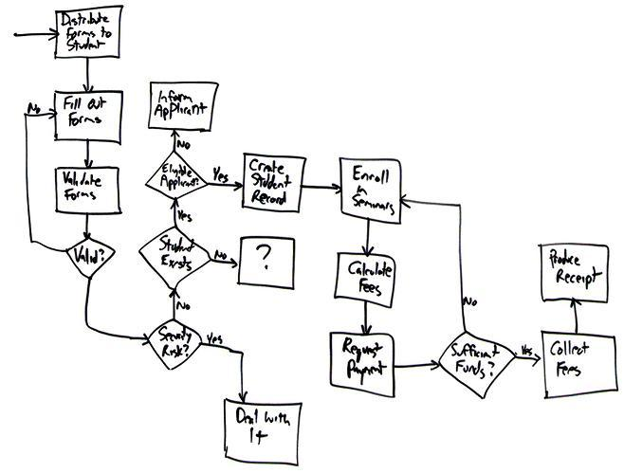
Flow charts and timelines
For topics including the Mechanics of Breathing, the Cardiac Cycle
Key dates, ideas, processes or stages
Add the information as you go along
Use different coloured pens or highlighters
Add images or diagrams.

Slide 9

Pair / Group Learning
Engage in video calling or voice calling with a friend about a topic
Talk through performance enhancing substances, effects of exercise, ways to reduce hooliganism
Engage with getting a parent, sibling or family friend to test you
Engage in conversation to enable you to improve you explanation, description on a topic

Slide 10
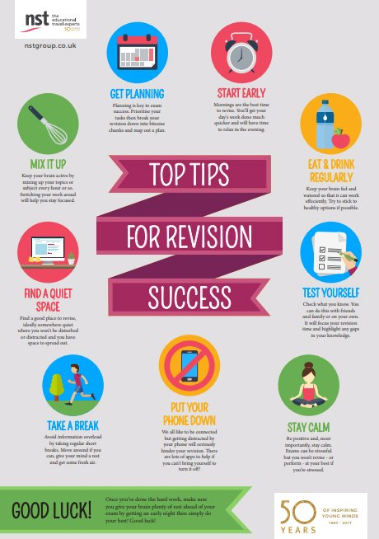
These are the basics…
But find what works for you!

Slide 11



Interactive Software
There is a variety of software available to help with your revision
These three help with your ACTIVE learning as they have opportunities to:
Think
Answer Examination Questions
Check for your understanding

Slide 12
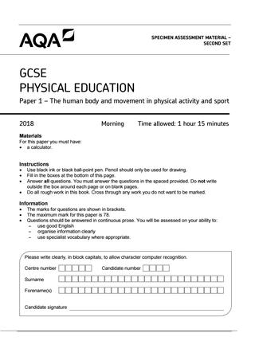
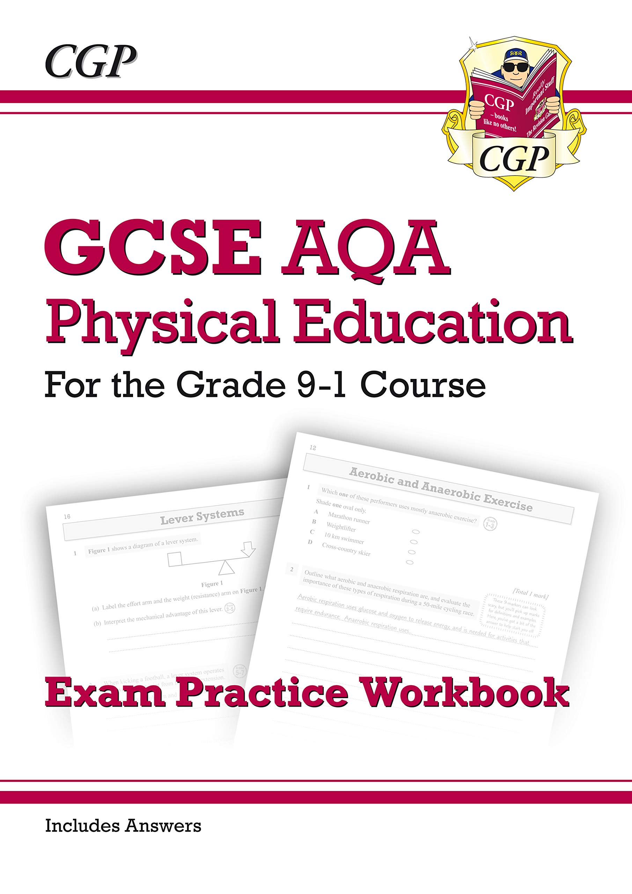
Exam Practice/Guides
Exam practice is like training your body for a sport/performance
Be honest with yourself!
Time yourself
Use mark scheme to self assess
Use mark scheme to construct a better answer
Identify what your strengths and weaknesses
Use the AQA GCSE PE Website:
Assessment Resources to access past paper questions & answers!!
https://www.aqa.org.uk/subjects/physical-education/gcse/physical-education-8582/assessment-resources

Slide 13


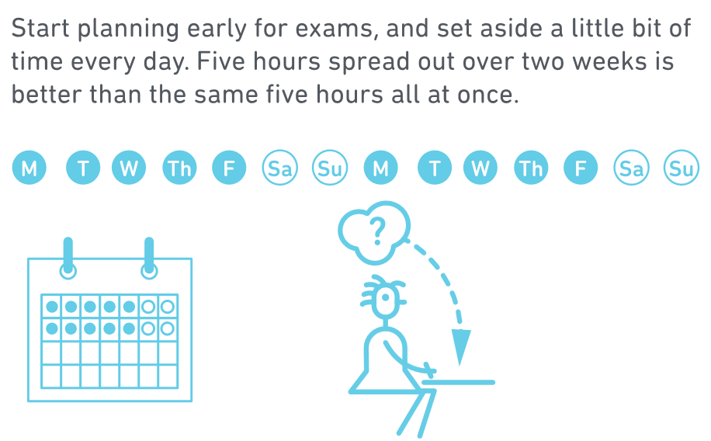
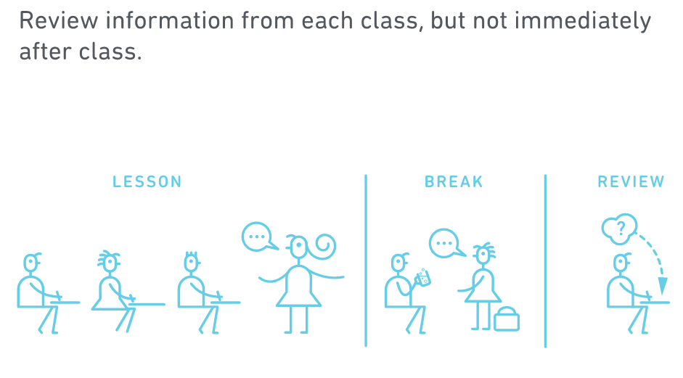
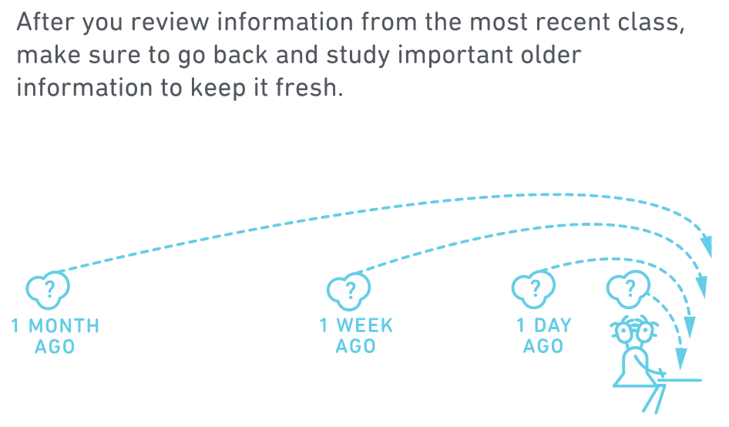
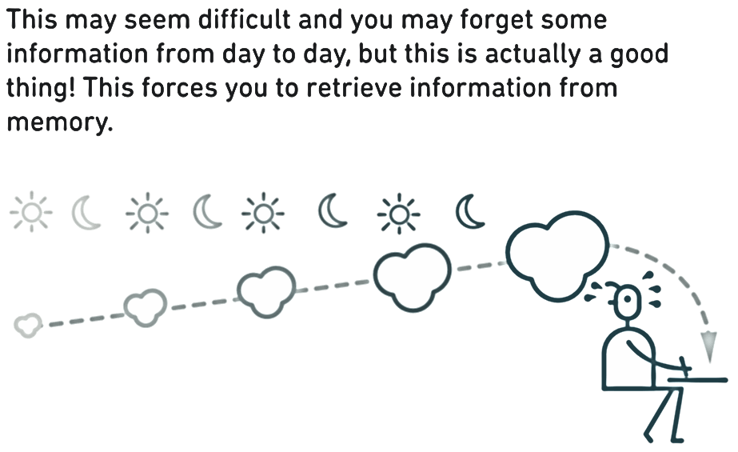

Slide 14
WHAT CAN PARENTS DO?
Useful websites:
To improve descriptive/narrative writing for English Language Paper 1, Q5: Pobble 365
http://www.pobble365.com/ (requires sign up)
To improve SPaG (useful for all exams):
Bristol University – Improve your Writing: Grammar Exercises
http://www.bristol.ac.uk/arts/exercises/grammar/grammar_tutorial/index.htm
To revise and test key skills for English Language and English Literature: BBC Bitesize (select AQA)
Language - https://www.bbc.com/bitesize/subjects/zr9d7ty
Literature - https://www.bbc.com/bitesize/subjects/zckw2hv
To revise content for English Literature: Course Hero
https://www.youtube.com/c/coursehero/search?query=jekyll%20and%20hyde
Encourage students to read little and often from a wide range of fiction and non-fiction texts
follow a blog
download a news app and stay abreast of current events
read short stories and novellas
Discuss what is being read to ‘tease’ out meaning
Help create an effective revision timetable and ensure it is being followed
Encourage students to complete past papers/questions to practise strategies and time-keeping
Advise students attend all available interventions
Ensure that set texts have been re-read

Slide 15

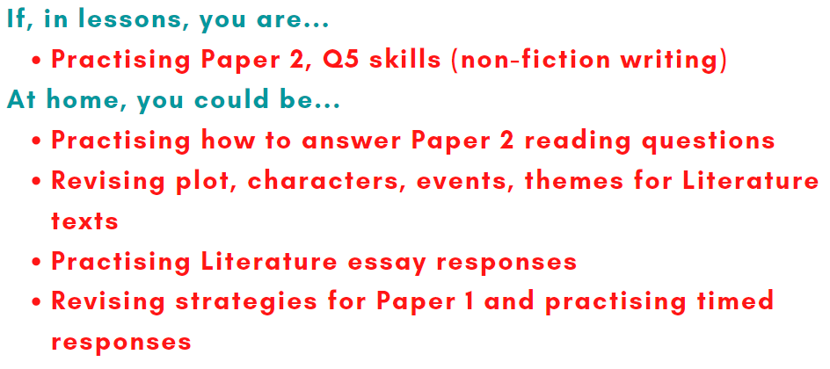
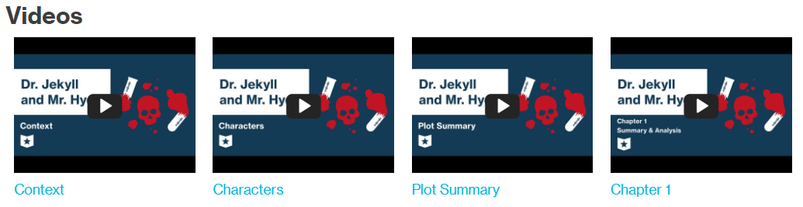
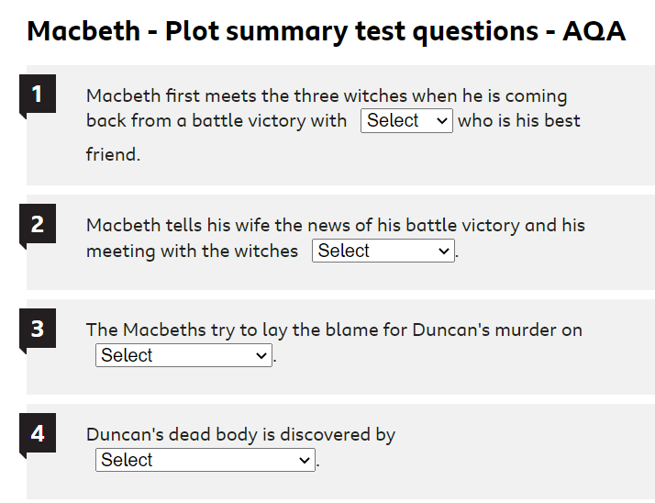



To improve exam strategy and time management: practise exam responses
To recap or test your knowledge: watch revision videos, complete online quizzes or make mindmaps
To help you memorise information: use dual coding or flashcards

Slide 16
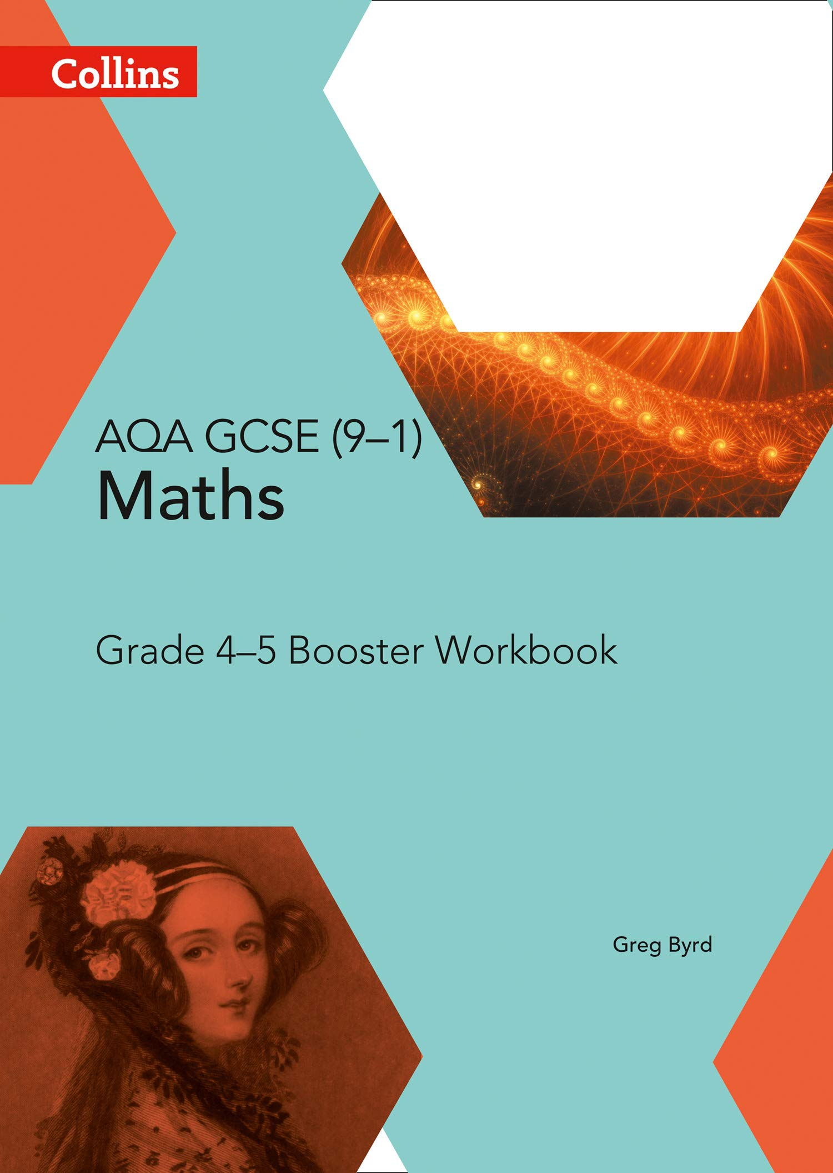

Top Tips for Maths
Booster workbooks:
Completing Maths questions daily
Pixl Maths (free phone app)
Weekly homework
Using year 10 booklets
Online resources e.g.
MathedupGCSE takeaway
Past paper style questions
(but not AQA papers)
Tons of questions at the right level with answers
£2.99 if you would like to get one from school
You could bring this to revision sessions!
Revision guides:
Revision and practise questions
£5 if you would like to get one set from school
A great resource if you are not sure where to start
Learning formulas!
Tasks are split into grades/or Foundation/Higher:
https://www.mathsgenie.co.uk/gcse.html
https://www.mathedup.co.uk/gcse-maths-takeaway/
https://corbettmaths.com/contents/
On all of these websites you will find exam questions, answers and links to the videos if you get stuck!

Slide 17
Computer Science
The Curriculum is J277 OCR Computer Science.
You have access to an electronic revision book (via google classrooms).
The first 37 pages cover paper 1 and the rest of the book is paper 2 (plus some exam style questions at the back).
There are also very good resources at Isaac Computer Science:
https://isaaccomputerscience.org/topics/gcse?examBoard=all&stage=all#ocr
Revision cards are very useful, you can flick through the quick questions and find out which topics need revisiting, once again the cards are divided around the halfway stage into Paper 1 and Paper 2:
https://www.cgpbooks.co.uk/secondary-books/gcse/computer-science/cof42-gcse-computer-science-ocr-revision
Drama
You will be provided with a revision booklet by your teacher. You can revise ‘Blood Brothers’ by looking at key characters, costume, set and key scenes. There are also resources on BBC Bitesize that can help you with this.
Food and Nutrition
https://www.bbc.co.uk/teach/class-clips-video/design-and-technology-gcse-food-preparation-and-nutrition/zvjh8xs
Watch ALL of these videos
For Student Digital Book access:
Please use the following username and password,
Student Username: SSHIRLEY4 Student Password: STUDENT4
https://www.illuminate.digital/eduqasfood/
Check the green F for videos.
https://www.bbc.co.uk/bitesize/subjects/zdn9jhv
Great information, videos and mini tests

Slide 18

Geography
In Geography students have been given a revision booklet which outlines the topics that will be in the year 10 Geography exam (Natural Hazards, Living World and Urban Issues and Challenges). It also includes a timetable for their revision homework, which has a mixture of case study revision and Seneca revision. Useful websites to help students revise include:
Seneca – see Google classroom for the assignment links
Time for Geography
Tutor 2 U
History
Knowledge check documents are on Google Classroom
Websites for Norman Conquest
Video playlist:
https://www.youtube.com/watch?v=ht3w-aaC-1s&list=PLj42bsxrdE2nGSX8YF6whVC_FvwJqDUk2
Seneca=
https://app.senecalearning.com/classroom/course/7414bb05-760e-4edc-91fe-5622586e2bd1
Websites for People’s Health:
Video Playlist:
https://www.youtube.com/watch?v=ZITrMcUmV2Q
Seneca =
https://app.senecalearning.com/classroom/course/4909e1df-a520-432d-9047-cc58dfb44744
BBC Bitesize =
https://www.bbc.co.uk/bitesize/topics/zrc7m39
Seneca for OCR B History
People’s Health =
Norman Conquest =
https://app.senecalearning.com/classroom/course/7414bb05-760e-4edc-91fe-5622586e2bd1
Science
www.senecalearning.com for revision of all topics in the curriculum
www.cognituedu.org for practising exam questions with mark schemes.
We recommend Oxford Revise revision books which come in foundation, higher or separate science.

Slide 19
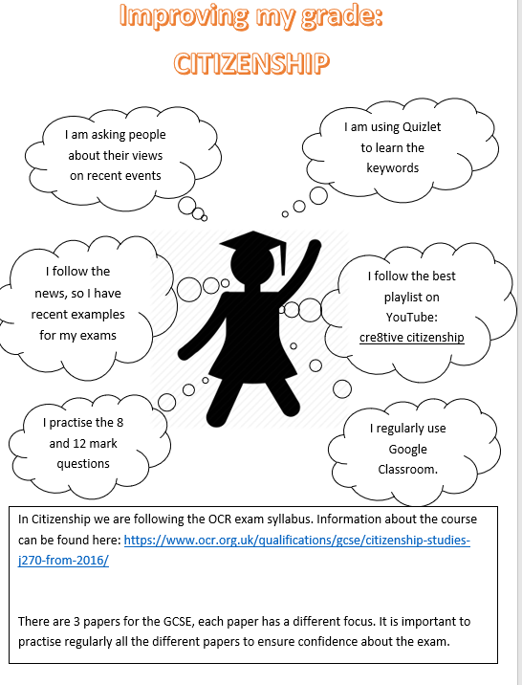
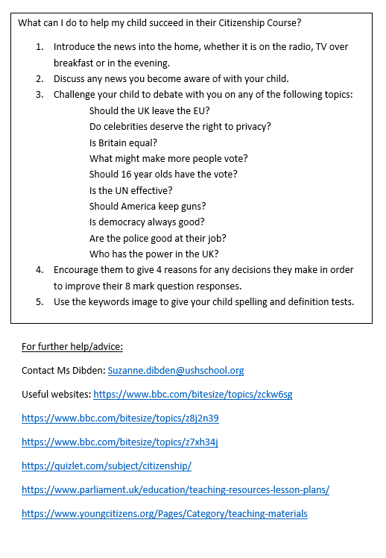

Slide 20
Music
Make sure you are fluent with the Elements of Music and what they mean as all questions will relate to them: Dynamics, Rhythm, Articulation, Structure, Melody, Instrumentation, Tempo, Texture, Tonality, Harmony (Remembered as DR A SMIT(TT)H!)
Learning key words is important but so is learning what they SOUND LIKE! For example, if you know what a pedal note is in theory, your next step is to research examples to listen to.
Prioritise learning the basic details of the set pieces (Badinerie by Bach and Africa by Toto); make sure you can describe them using all of the elements of music.
There are huge amounts of lessons including quizzes and listening examples on Focus on Sound, which we are subscribed to as a department, so make use of it! You can log in via Portal.FocusonSound.Com
The best textbook to buy and have is the Eduqas GCSE Music Textbook by Jan Richards (published by Illuminate). Both the Textbook and separate Revision Guide are very good to use. They go in to advanced detail for GCSE and so are really good at pushing yourself up a grade or two. Be sure to get the latest edition as older copies will have the old set pieces in them which aren’t relevant to us.
RS
There are knowledge organisers on Google Classroom.
Useful websites: https://classroom.thenational.academy/units/christian-beliefs-and-teachings-700f
https://classroom.thenational.academy/units/christian-practices-173f
https://www.bbc.co.uk/bitesize/topics/zbndy9q
https://www.bbc.co.uk/bitesize/topics/zrfj382
It is also recommended that students purchase the RS revision guide. It is £5 on the My Child at School app.
There are also resources on Google Classroom.
Finally, I recommend students to look over and practice past Christian and Hindu papers. These can be found on the AQA website: https://www.aqa.org.uk/subjects/religious-studies/gcse/religious-studies-a-8062/assessment-resources

Slide 21
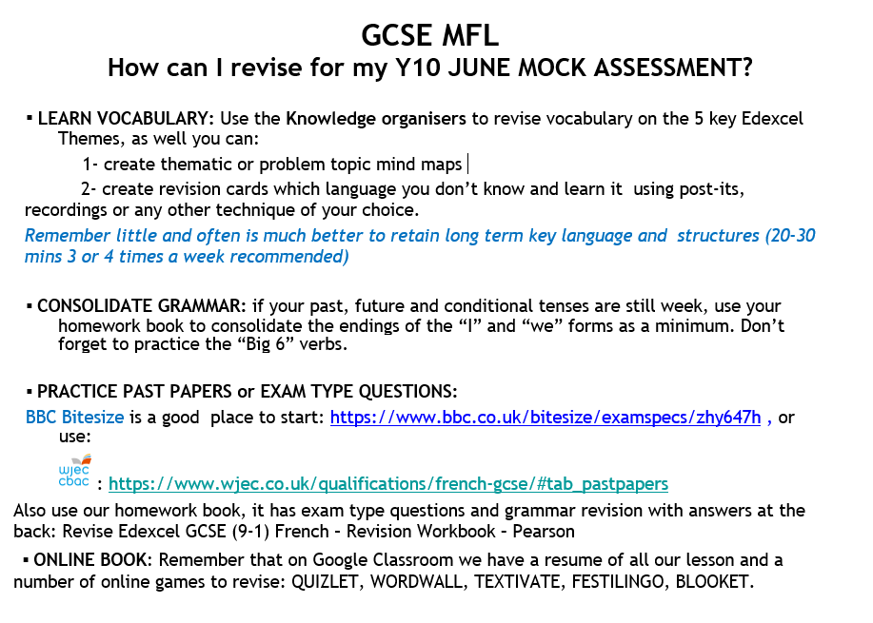

Slide 22
College Open Events
Barton Peveril
Tuesday 4th July 4:30pm – 9pm (bookable on their website)
Peter Symonds
Wednesday 5th July 5:30pm – 8:30pm
Thursday 6th July 5:30pm – 8:30pm (bookable on their website)
Totton College
Tuesday 6th June 6:30pm – 8:30pm
City College
Saturday 17th June 10am – 12pm
Richard Taunton Sixth Form
Wednesday 28th June 6pm – 8pm

Slide 24
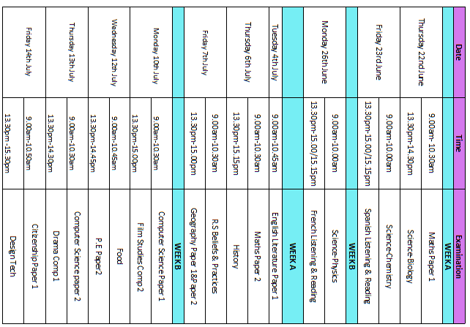
Year 10 Mock Exams

